Slide 1


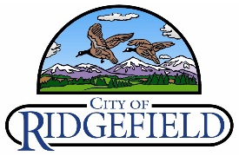
Downtown Ridgefield
Planning & Development
Open House Presentation
June 18, 2015

Slide 2
Agenda
Background
Project Purpose
Environmental and Market Assessment
Conclusion

Slide 3
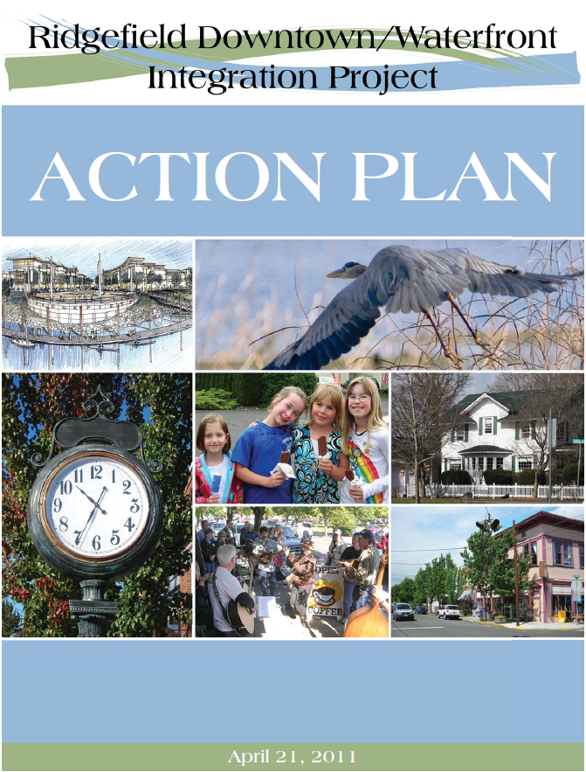
Background
Strategic Core Values
Capitalize on Natural Environmental Assets
Create A Complete Community: Live, Work, Play
Capitalize on Regional Innovation Economy

Slide 4
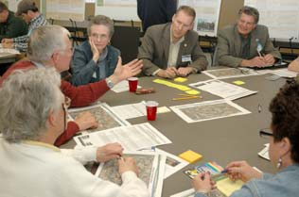
Report Card

Slide 5
Background
General Policy Recommendation
“Cleanup and redevelopment of downtown brownfield properties in core downtown area to create economic critical mass”

Slide 6
Project Objectives
Implement “Ridgefield Downtown/Waterfront Integration Project Action Plan”
Evaluate potential catalytic value of identified brownfield properties
Provide a baseline for the adoption of a Downtown Subarea Plan

Slide 7
Planning Area

Slide 8
Market Analysis
Ridgefield is the fastest growing town in Washington State
Vacant, prime real estate:
  Downtown: 6 acres
  Waterfront: 40+ acres
Industry Growth Areas
  Residential: serving empty nesters, seniors, young creatives
  Recreation & Hospitality: in conjunction with the Refuge
  Office Space: serve local professionals and creative firms
  Flex & Industrial Space: fit well with waterfront
  Market Hybrids: realistic market opportunities (e.g. mixed use)

Slide 9
Market Analysis
Key development concepts suggested by this market analysis
Village residential
Independent boutique retail
Destination wildlife reserve attractors
Professional and creative services
Corporate campus
Live-work mixed use

Slide 10
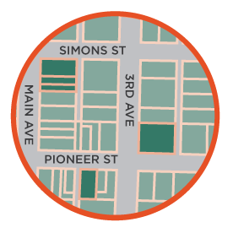
Focus Properties
Park Laundry
Bus Barn
Weeks Property

Slide 11
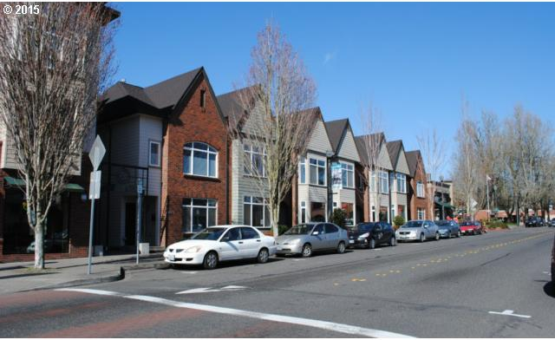
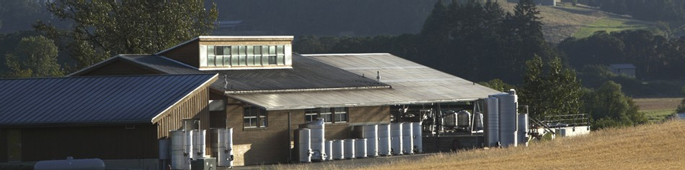
Redevelopment Scenarios
A four story development with ground level retail and apartments above
Four live/work townhomes with shop space on the ground floor and living space on two floors above
1, 2 and 3-story structures – with office floors ground level retail
A multi-tenant ag-production facility with an event/public area

Slide 12
Feasibility
Cost of remediation exceeds value of development
Current Downtown rental rates do not support redevelopment
Feasibility limited by zoning restrictions on density in Downtown

Slide 13



Conclusion
Objective
Create the climate for Downtown revitalization
Revitalization Strategies
Infrastructure and regulatory platform to accommodate development | Link development of waterfront with downtown |  | Initiate waterfront development | Capitalize on the Refuge | Support development of Downtown properties | Generate adequate resources to sustain economic growth
Mechanisms
Subarea plan Pioneer St. corridor study Revise downtown zoning | Attract an anchor Identify mutual targets | Park along the waterfront Refuge trail and connection |  | Branding exercise Programming (i.e. events) Portal community | Brownfield properties Assist RSD in developing Bus Barn Identify opportunities for property consolidation | Balance development among satellite areas Urban Refuge Program

